Slide 1
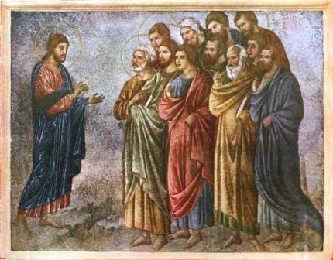
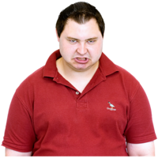
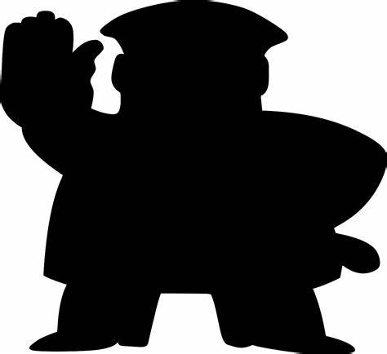
The Easter Story
Jesus of Nazareth lived over 2000 years ago in the Middle East (mainly in the Country now called Israel).
Christians believe that Jesus was the Son of God.
He travelled around, telling people that they should live good lives, and believe in God.
The Bible tells of Jesus doing many amazing things - called Miracles.
He had many people who followed him. His 12 closest supporters are called the Disciples or Apostles.
Some people were angry about what Jesus was doing – and they didn’t believe he was the Son of God.
The people in power believed he must be stopped, even if they had to kill him.
The Include Project - Registered Charity No: 1177785
© The Include Champions group, Include.org 2022
This Easy Read resource is free for non-commercial use.
Not permitted for commercial purposes without permission.

Slide 2
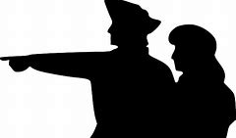
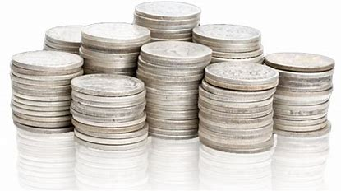
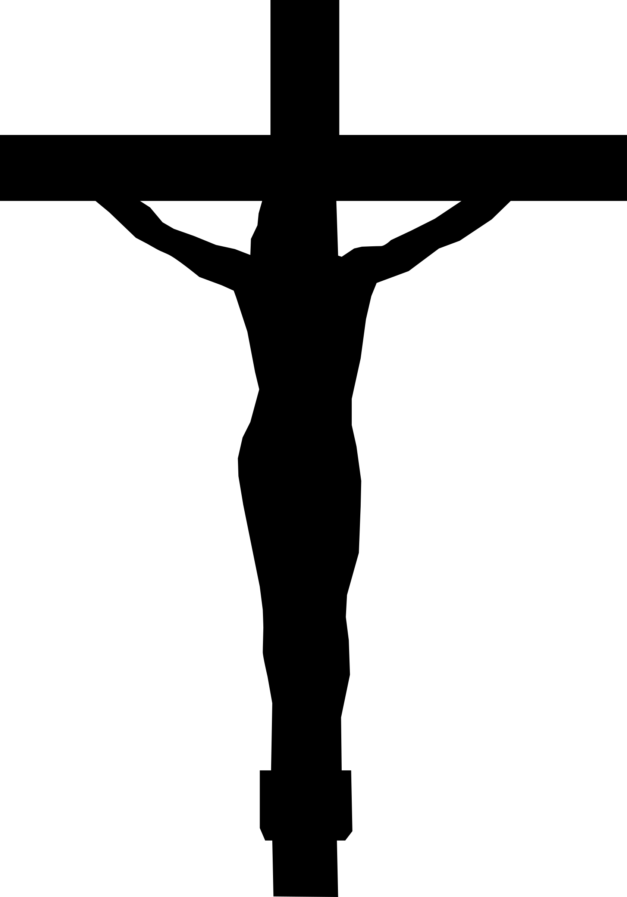
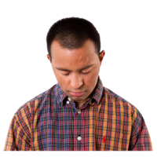
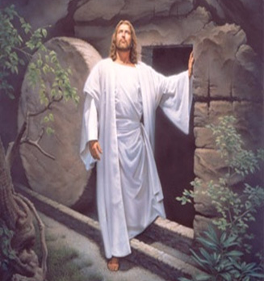
One of Jesus’ Disciples – called Judas Escariot – told the Government Officials where to find Jesus.
Judas was paid 30 pieces of silver for this information.
Jesus was captured and hung on a cross to die.
After He died, his body was put in a cave covered with a big stone.
His followers were very sad.
But after 4 days, the stone rolled back and Jesus was alive again. He joined God in Heaven.
This is the Miracle that Christians celebrate every Easter.
The Include Project - Registered Charity No: 1177785
© The Include Champions group, Include.org 2022
This Easy Read resource is free for non-commercial use.
Not permitted for commercial purposes without permission.

