Slide 1


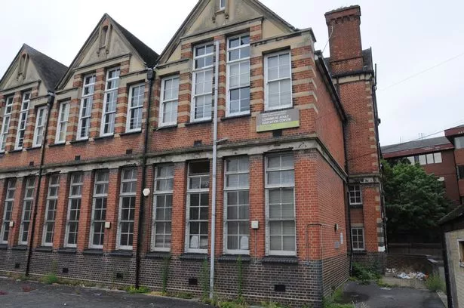







Ready, Steady, Cook!
Date: Thursday February 15th
Time: 11am arrival
Where: Longmead Centre in Redhill, accessible parking available
Cooking time: 11:30am - 12:15pm
Judging: 12:15 -12:45pm
Social bring and share lunch: 1:00 – 1:45pm
Project Presentations: 1:45 - 2:15/30pm
‘Sharing our work completed together so everyone has the opportunity to bring to the day what they have done as part of this Voluntary Action Reigate & Banstead funded partnership’

