Slide 1




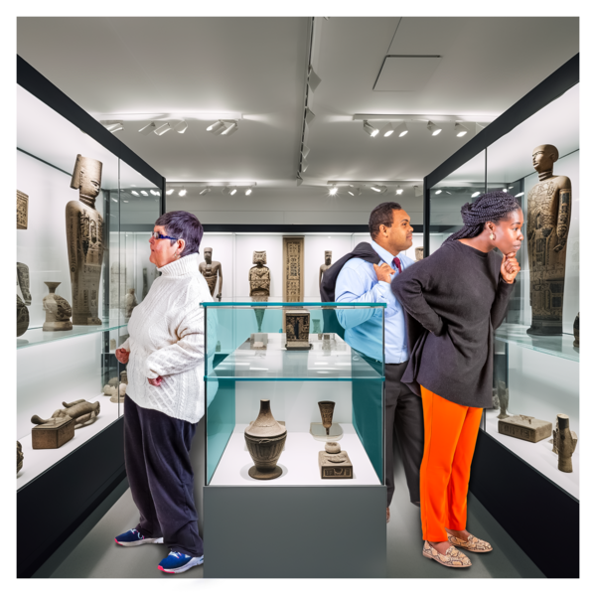









Singing at CFS Birthday!
Please join us to sing at the Community Foundation for Surrey’s birthday event! This will be at a private residence in Churt, on Thursday 11th September 2025.
There will be another choir singing and the opportunity to look at some old cars!
We will meet in Redhill opposite Sainsburys at 3 pm and travel together by minibus. We will return to Redhill by 8pm.
You will need to wear your choir polo shirt and smart black bottoms.
There will be some food provided, but please bring a drink and a packed tea with you.
Please let us know as soon as possible if you can come and sing!
Please email us on info@include.org with any questions you have.
The Include Project - Registered Charity No: 1177785

